Slide 1
D.Eco Sprint 4
Fiasal Alsabahn, Cory Harris, Morgan Brown, Kylie Pfaff

Slide 2
Purpose
Android and iOS application that allows students, faculty, and visitors to tour the trees on Drury University’s campus
Educate and engage users by providing an interactive way to learn about the trees on campus
D.Eco – May 7, 2018

Slide 3
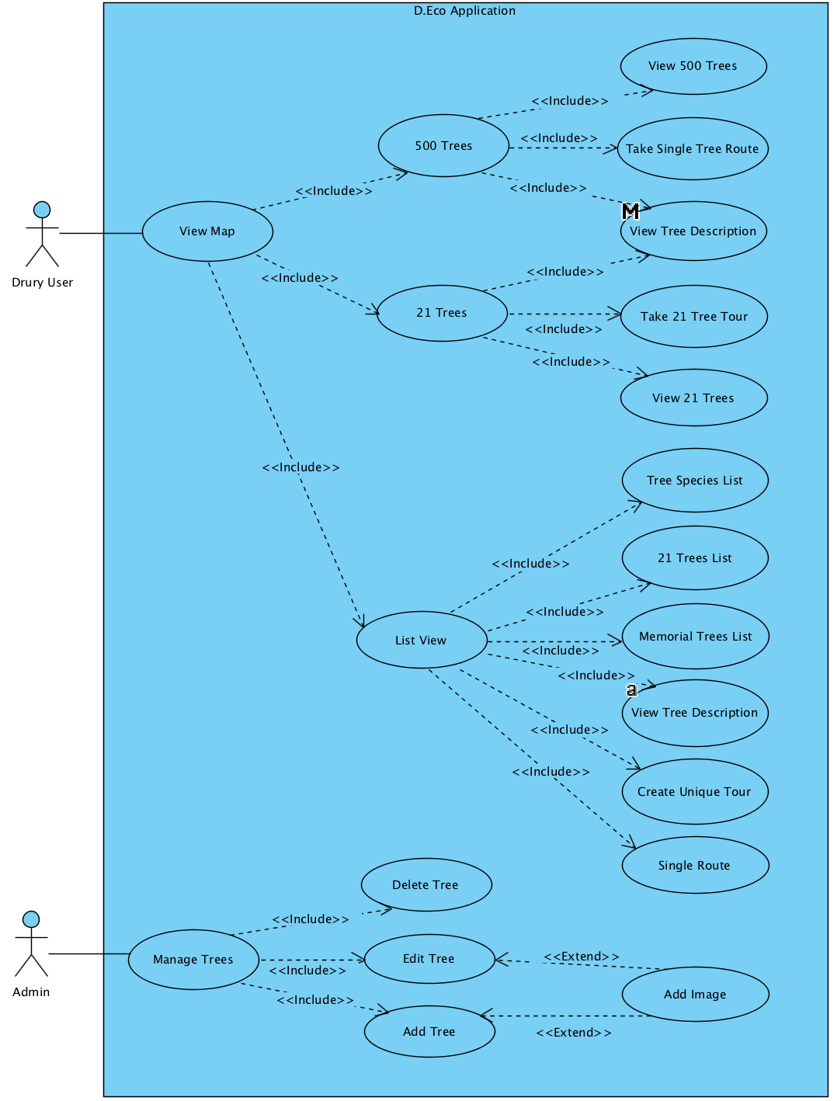
Sprint 4 Use Case Requirements – View Map
D.Eco – May 7, 2018

Slide 4
Sprint 4 Use Case Requirements – List View
D.Eco – May 7, 2018

Slide 5
Sprint 4 Use Case Requirements - Admin
D.Eco – May 7, 2018

Slide 6
Sprint 4 Acceptance Plan
 | Requirements | Completion
View Map | X | X
View 500 Tree | X | X
Take Single Tree Route | X | X
View 21 Trees | X | X
View Tree Description | X | X
Take 21 Tree Tour | X | X
Update Tour |  | X
List View | X
Tree Species List | X
21 Tree List | X
Memorial Trees List | X
View Tree Description | X
D.Eco – May 7, 2018

Slide 7
Sprint 4 Acceptance Plan
 | Requirements | Completion
Create Unique Tour | X
Single Route | X
Manage Tree | X | X
Delete Tree | X | X
Edit Tree | X | X
Add Tree | X | X
Add Image | X | X
D.Eco – May 7, 2018

Slide 8
Technologies
iOS
Swift
MapKit
Android
Java
Google Maps
Web Development
PHP - apache
Amazon Web Services
Database
MySQL - Workbench
D.Eco – May 7, 2018

Slide 9

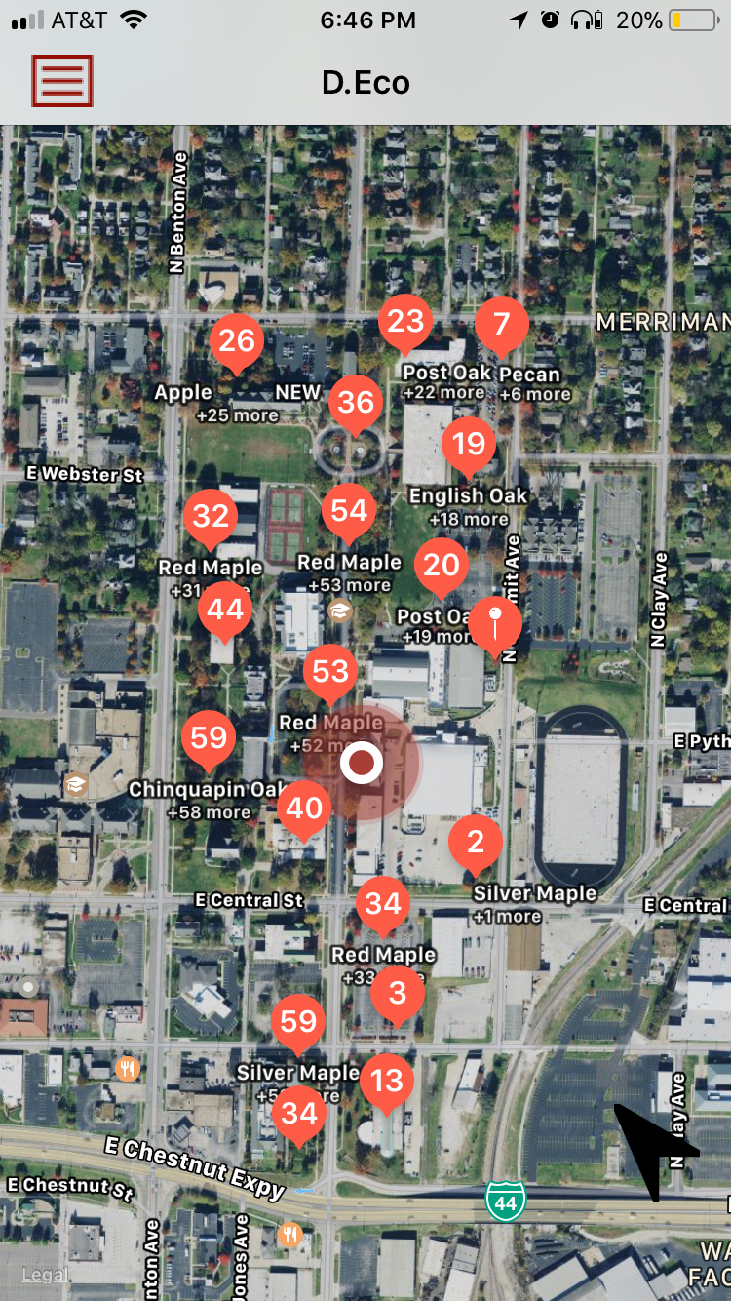
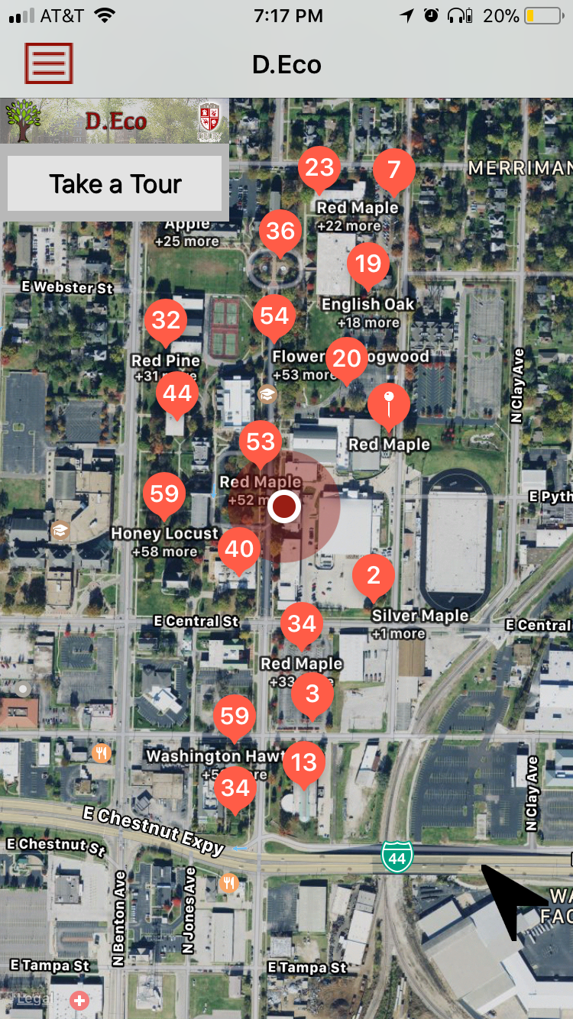
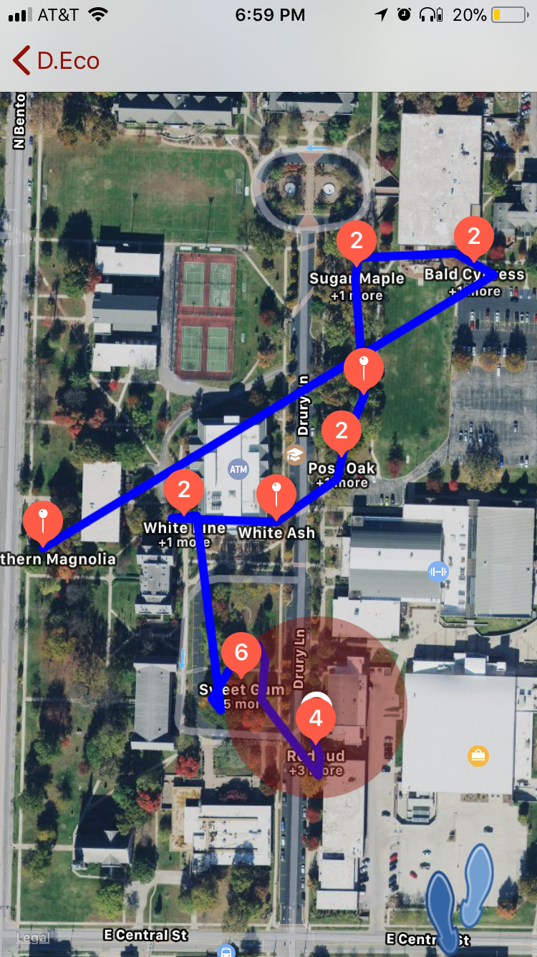
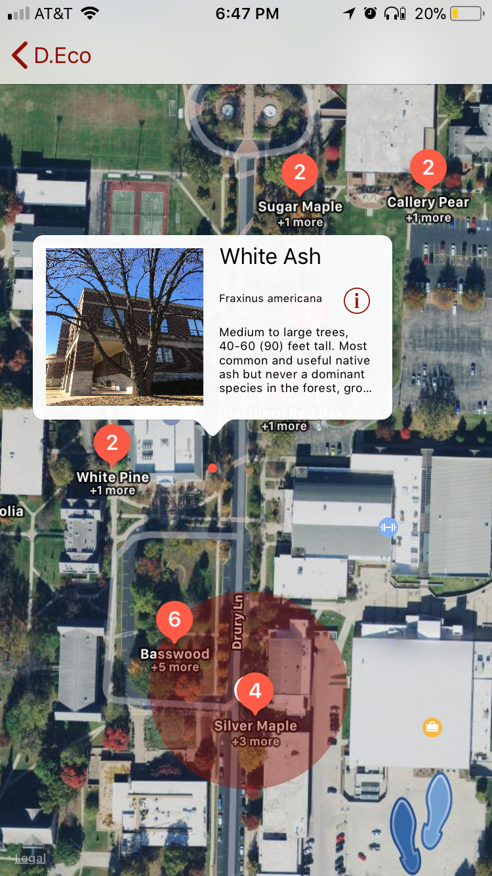
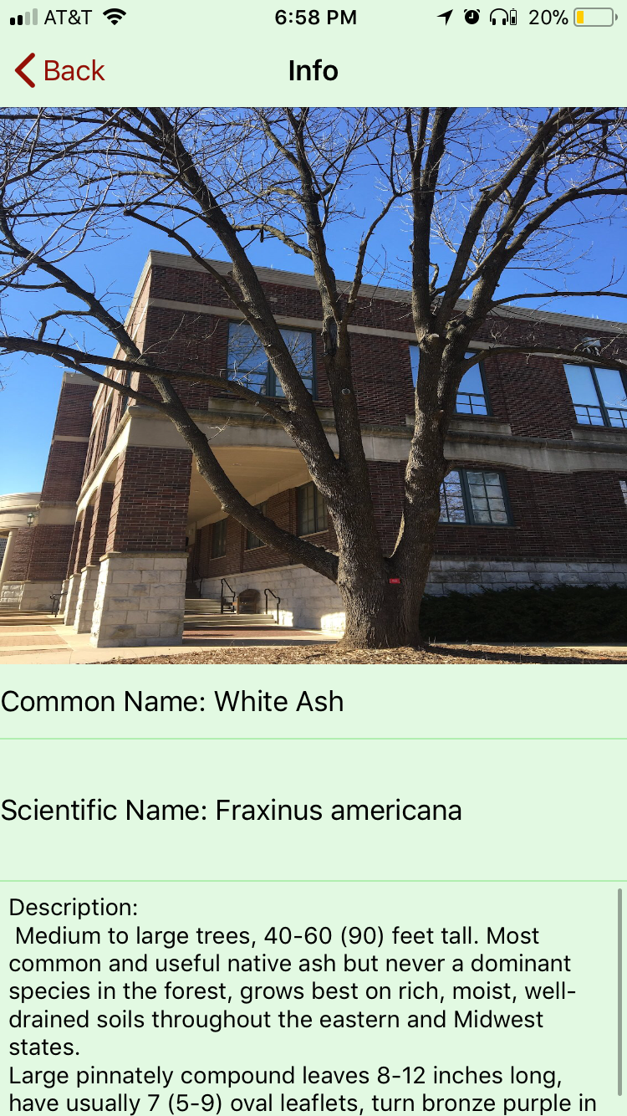
User Interface - iOS
Splash Screen
Tree Map (559)
Main Menu
21 Tree Tour
Description
Description
D.Eco – May 7, 2018

Slide 10

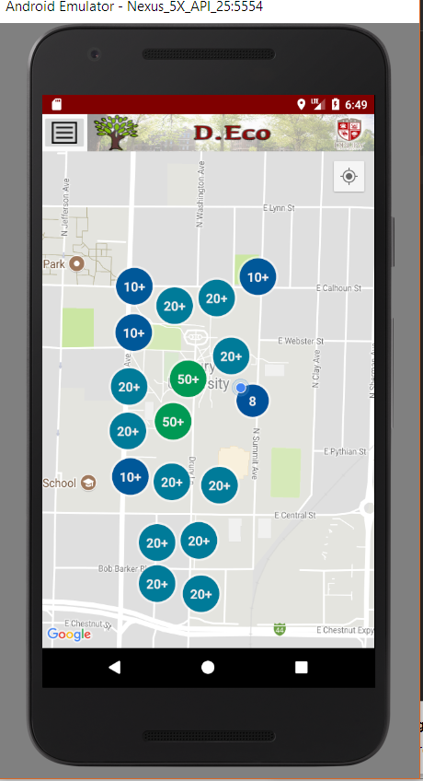
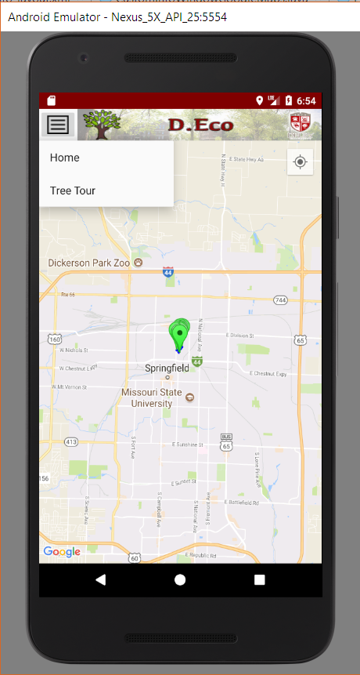
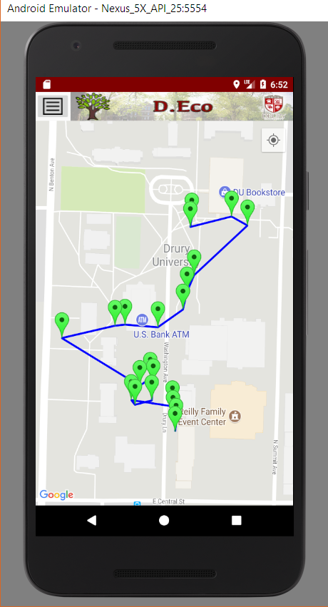
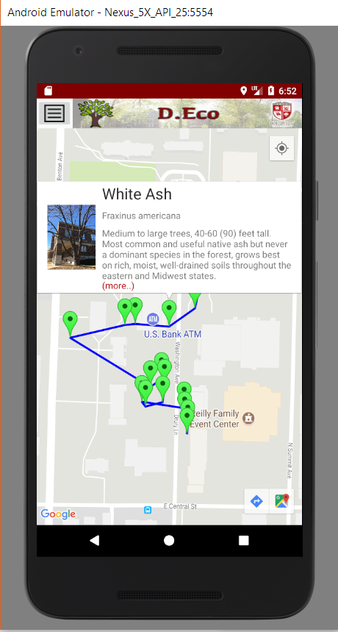
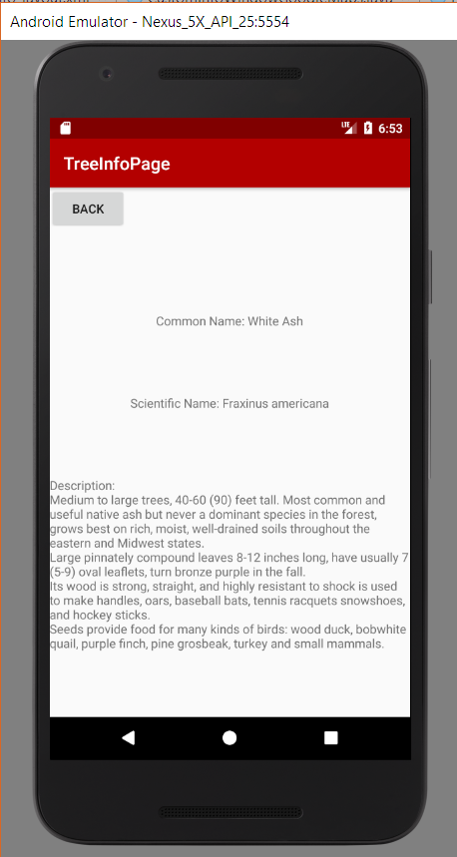
User Interface - Android
Splash Screen
Tree Map (559)
Menu
21 Tree Tour
Description
Description
D.Eco – May 7, 2018

Slide 11
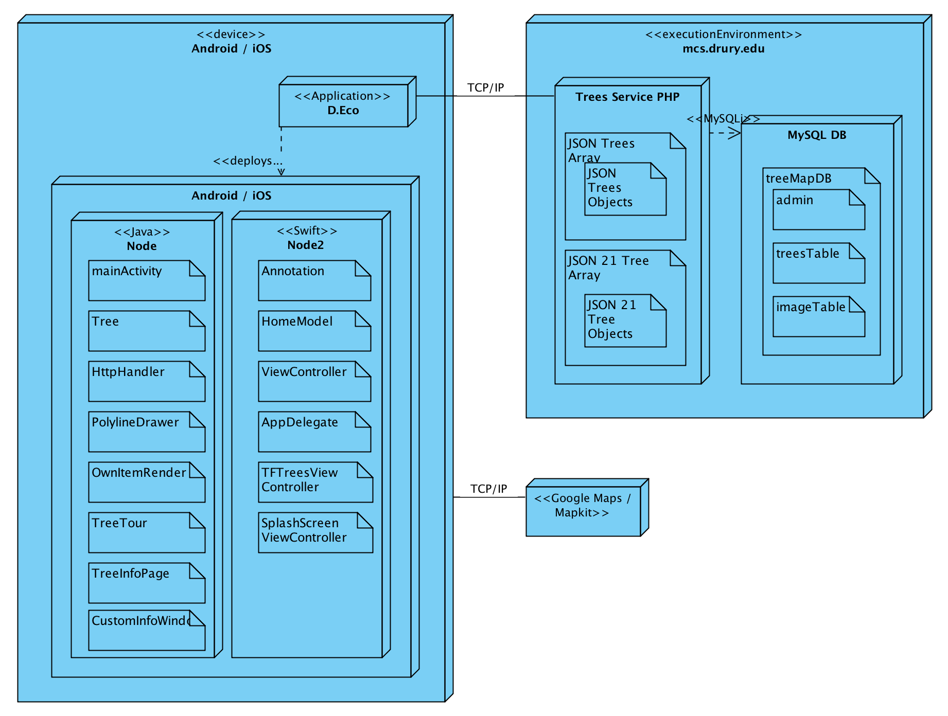
Architecture
D.Eco – May 7, 2018

Slide 12
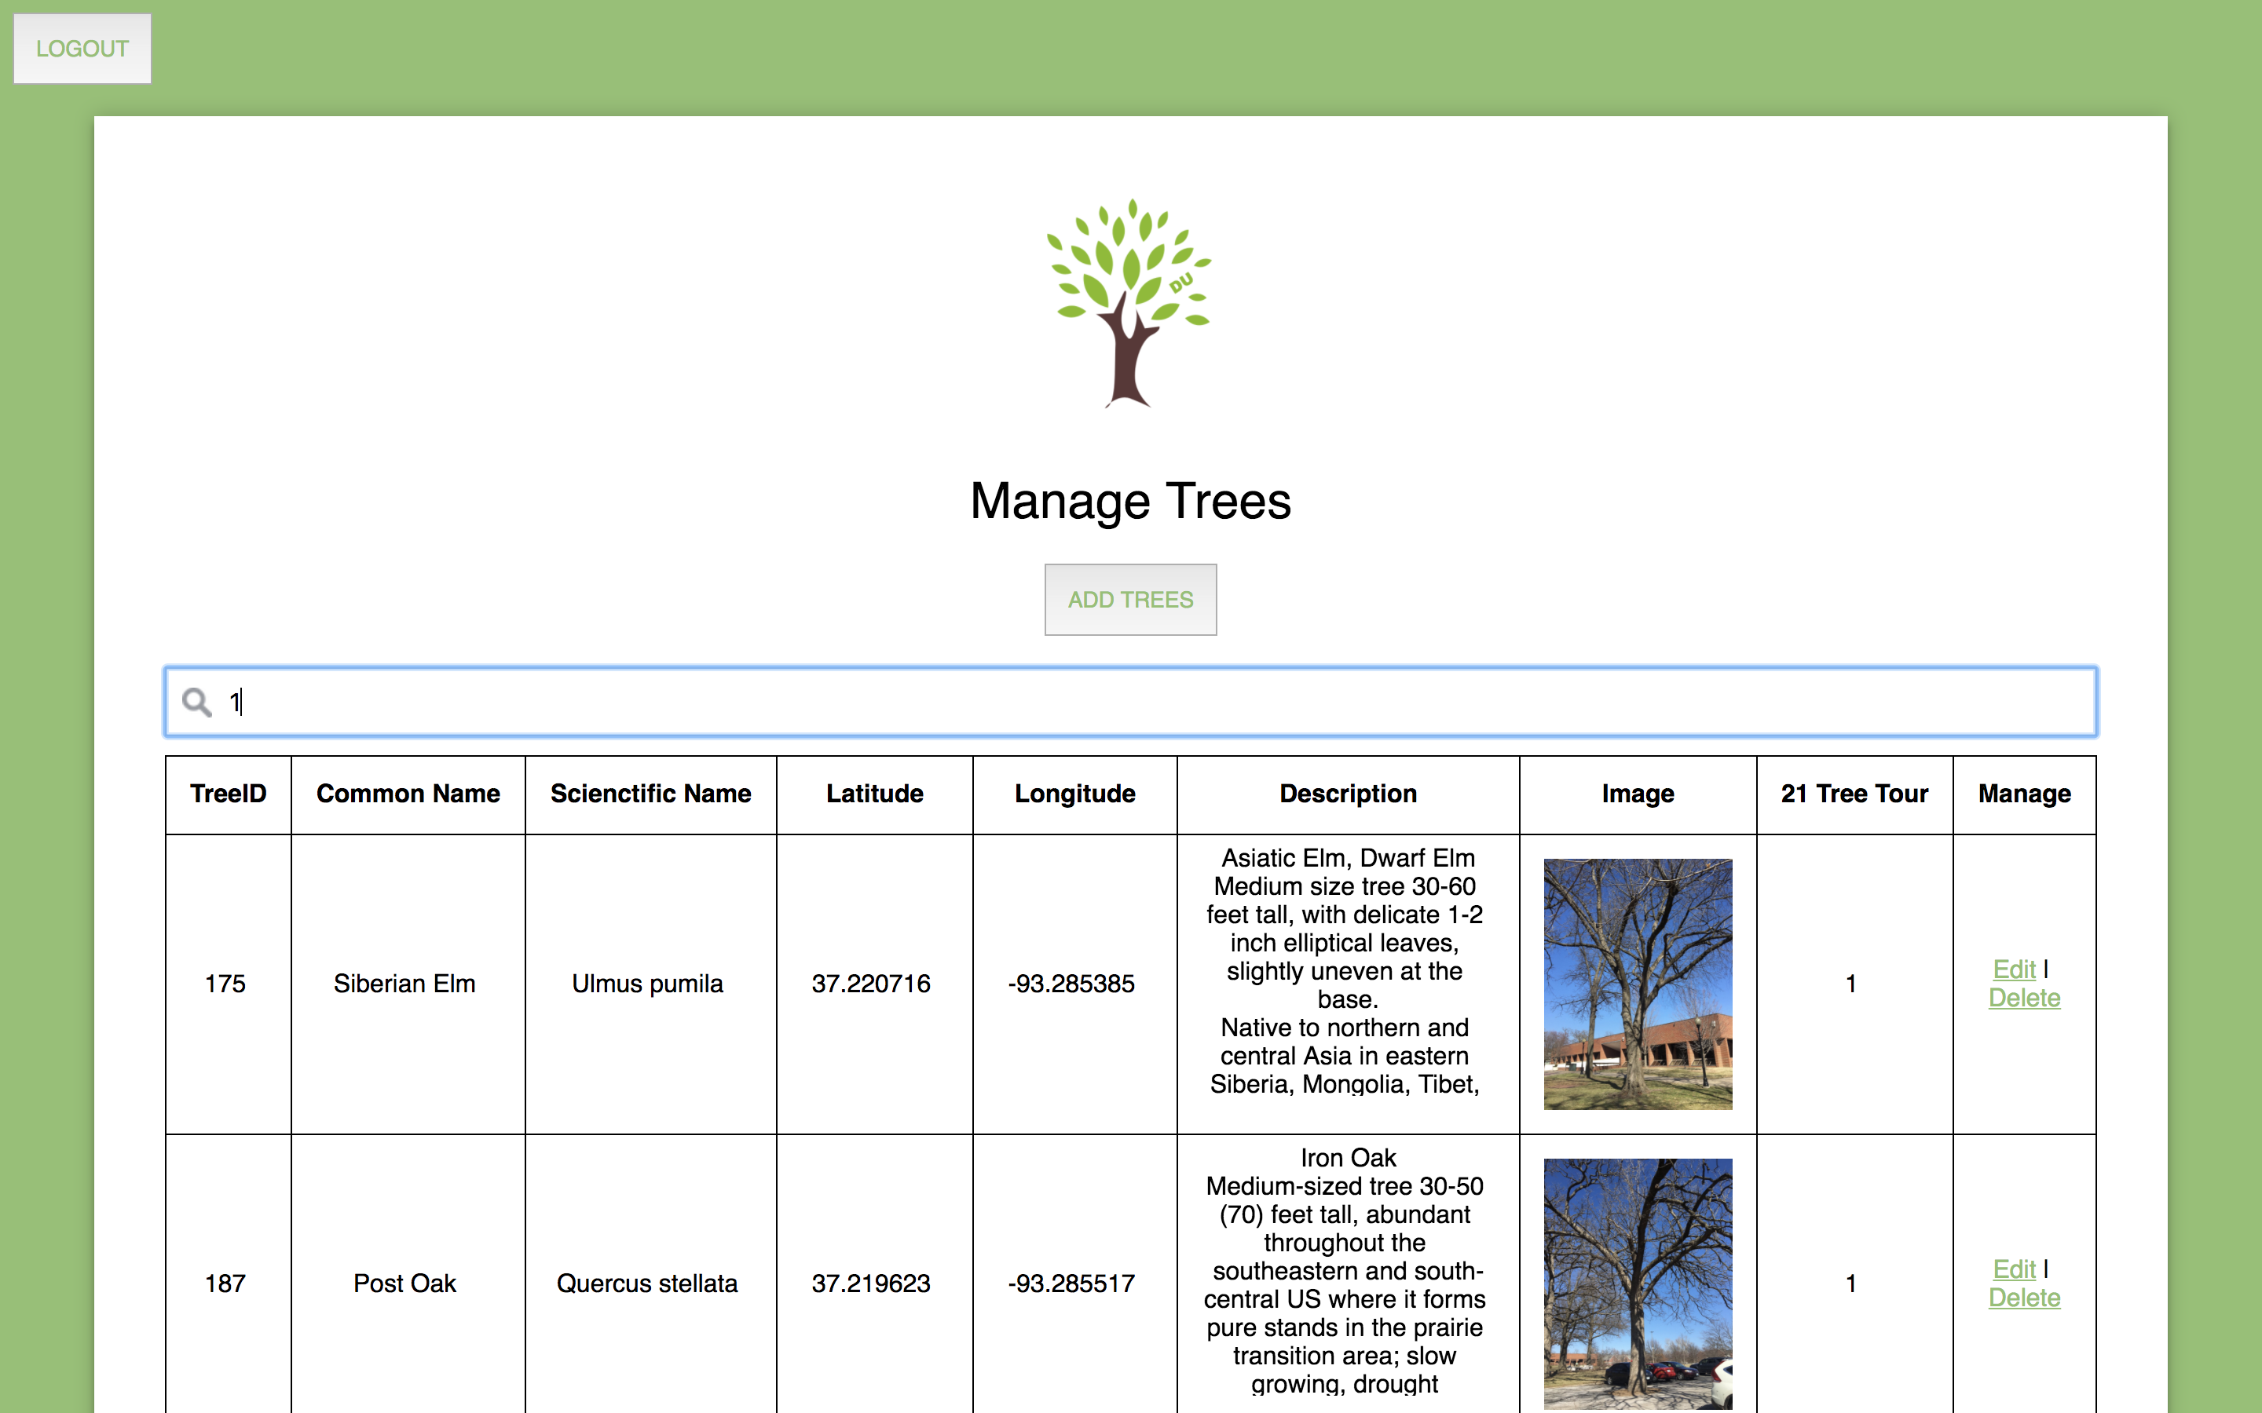
Admin Page
D.Eco – May 7, 2018

Slide 13
Testing Plan
Plan
Deploy both versions of the app onto Biology students phones
Students use the app to report issues in the software or tree data
Result
Deployed to both versions on student phones
Developer testing to find bugs
D.Eco – May 7, 2018

Slide 14
Future Direction
Issues
Android – Image timing issue
iOS/Android - Change static URL calls to be encrypted in a config file
Admin – testing every possible case
Implementation
List View – tree species, 21 trees, memorial trees
Create Unique Tour & Single Route
Extended functionality to grasses and buildings on campus
D.Eco – May 7, 2018

